Slide 1


Diversity in Public Relations
Notes:
Introduce purpose for the session and thank students for hosting us.

Slide 2

Diversity, Defined*
Definition of diversity
  plural diversities
1: the condition of having or being composed of differing elements : variety; especially : the inclusion of different types of people (such as people of different races or cultures) in a group or organization programs intended to promote diversity in schools
2: an instance of being composed of differing elements or qualities : an instance of being diverse a diversity of opinion
*Defined by Webster's Dictionary
Notes:
Define PR. Talk about how it is a mix of different strategies and tactics to build relationships and achieve goals. What does it mean to you?

Slide 3
PRSSA Diversity Initiative
The PRSSA National Committee launched a Diversity Initiative in 2005(Updated 2017). The Diversity Initiative states that PRSSA encourages Chapters to recruit and retain diverse membership and leadership representative of the demographic composition at their college or university.
Notes:
Define PR. Talk about how it is a mix of different strategies and tactics to build relationships and achieve goals. What does it mean to you?

Slide 4
PRSA’s Stance on Diversity
To champion diversity of thought, cultures, disciplines, ideals, gender, disabilities, sexual orientation and age in order to develop an inclusive Society. By reaching and involving members who represent a broad spectrum of differences, we will encourage and educate members about the benefits of a diverse profession by providing professional development, knowledge and support to help them succeed in public relations.
Notes:
Define PR. Talk about how it is a mix of different strategies and tactics to build relationships and achieve goals. What does it mean to you?

Slide 5
What Diversity Looks Like
Diversity is not a cookie cutter definition of just one segment of the population. Diversity is reflected on not only the outside but also the inside. There are inherent diversity such as sex, ethnicity, sexual orientation, etc. and there are acquired diversity traits which are gained through experience such as language skills, culture, etc.
Notes:
Take this time to explain the role of PRSSA. Explain how often your Chapter meets and other activities your Chapter does. Also, mention PRSSA as national organization and highlight things like National Conference, National Assembly and Leadership Rally.

Slide 6
How Diversity Impacts PR
The purpose of public relations is to establish mutually beneficial relationships between organizations and their publics. Since organizations typically have numerous publics it is imperative that each public have a voice in the relationship. Multiple perspectives creates a conversation, not a one sided story. When everyone is heard, everyone is equal.
Notes:
Ask,
Who here volunteers?
Who plays on a team?
In PR we try to put others first. We aren’t always the ones in front of the crowd. We get to have a lot of fun/fulfillment from behind the scenes.

Slide 7




International Chapters
PRSSA currently has three international chapters in Argentina, Columbia and Peru. International outreach was conducted to have an impact on public relations students beyond the United States.
Notes:
In PR, relationships are mutually beneficial, meaning both sides get something out of it. It’s just like how you are there for your family, and they are there for you in return. Relationships mean spending time with them and getting to know them. Both sides get value from the relationship.

Slide 8
The Benefits of Diversity
A study* conducted by the McKinsey Global Institute found that, “Companies in the top quartile for racial and ethnic diversity are 35% more likely to have financial returns above their respective national industry medians.”
  The above study shows that not only is diversity good for a working environment it also can have an affect on a companies bottom-line.
*http://www.mckinsey.com/business-functions/organization/our-insights/why-diversity-matters
Notes:
Talk about the things students can be doing now to get ahead. Show them how they can use social media to their advantage.

Slide 9
What Can You Do?
The first step should be to conduct a member assessment of perceived diversity issues.
Research your universities demographic composition and see if your Chapter reflects that.
Conduct a High School Outreach session at a diverse high school.
Apply for the Dr. F.H. Teahan Chapter Diversity Award (Next Slide)
Notes:
Show how core skills of PR are applicable to many various professions.

Slide 10
Chapter Diversity Award
Dr. F.H. Teahan Chapter Diversity Award
      Award: $300 and a plaque
This category recognizes outstanding commitment to diversity within the PRSSA Chapter. PRSSA is dedicated in its efforts to welcome and maintain a diverse membership and encourages Chapters to recruit members that represent the demographic composition at their college or university. We embrace members regardless of race, culture, gender, religion, education, age, disability, marital status, socio-economic background or sexual orientation. Judging criteria will include activities performed to promote, generate awareness and encourage diversity within your Chapter.
Notes:
How can they gain experience? This a great way to invite them to a Chapter meeting or PRSSA hosted event.

Slide 11



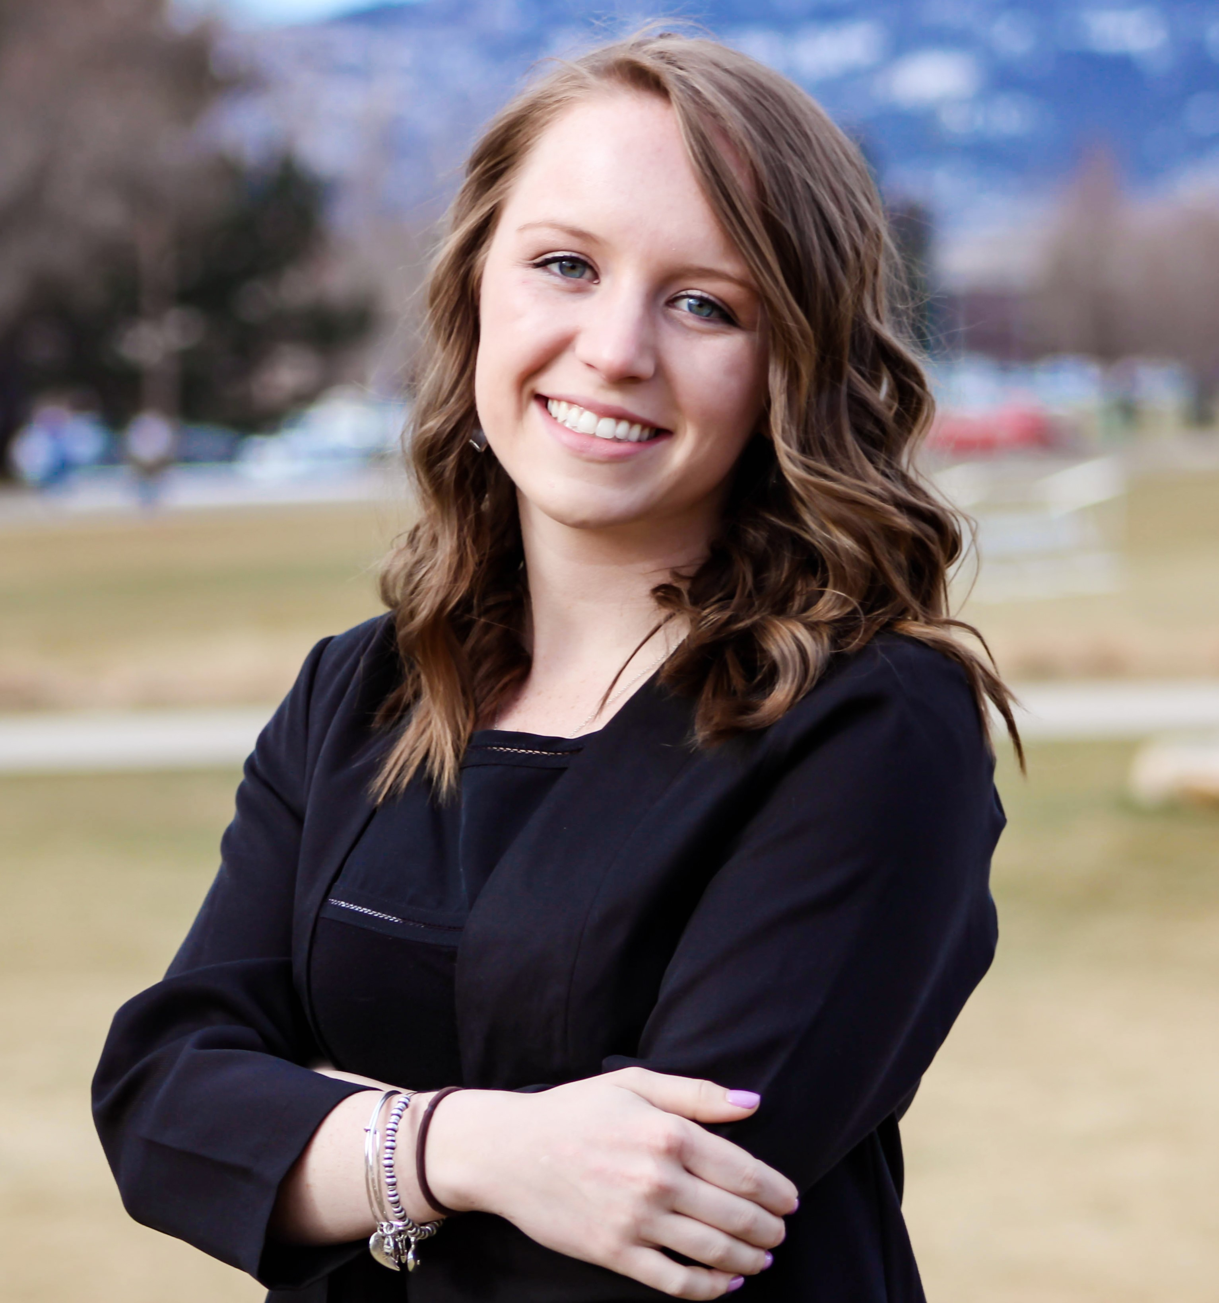



Connect With Our
National Committee
Andrew Cook
National President
@adcook22
Adcook22@gmail.com
Emma Finkbeiner
Immediate Past President
@efink101
Emfinky@gmail.com
Andrew Young
Vice President of External Affairs
@andjyou
Andrew.PRSSA@gmail.com
Allyson Berry
Vice President of Member Services
@allysonkberry
Allysonkberry.PRSSA@gmail.com
@PRSSANational
PRSSA National
@PRSSANational
Notes:
Leave this information as is, letting members know they may connect with the National Committee members. (Or, alternatively, alter it to your personal contact information and change the headline accordingly.)

Slide 12
Questions?
Thank You!
Notes:
Take questions

