Slide 1
How to build diversity in your PRSSA chapter
Webinar—February 4, 2019

Slide 2
Several years ago we added a:
Diversity and Inclusion Director to our eboard. We felt it was essential to who we are—and our mission is to include diversity and inclusion in all we do.

Slide 3
Our mission is to represent diversity
Membership—we don’t just recruit students who are in the School of Communication to join PRSSA. We recruit students from other schools at the university --but we also made it a point to let students know we want diversity and we care about having an inclusive chapter

Slide 4
Example of our recruiting campaign
https://screenshots.firefox.com/Lw2wMhdyEyfx9VAz/null

Slide 5
We also reach out to High School students
in our community. Each year, our diversity director and several other students in our chapter, visit my alma mater—which is an hour away. It is a diverse school and one of the top schools in the county.
The students from our chapter prepare a great presentation about public relations, what it is, its importance, messaging, and its impact.
Our mission is to encourage students to understand our field, so that when they enter college, they may want to major in public relations.

Slide 6
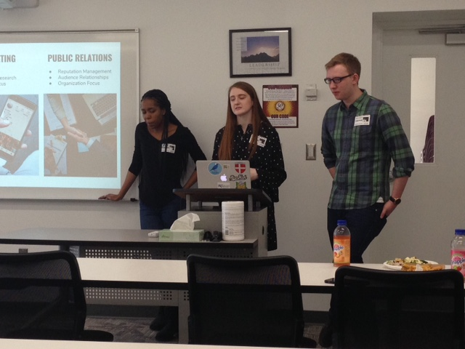
Students last year

Slide 7
We have also reached out to PR firms in area
We have invited Edelman to come and speak to our chapter. Edelman has committed a great deal to Diversity in their firm. Renee Edelman, as well as the head of the DC office will serve on a panel, along with a rep from the Bill and Melinda Gates Foundation and a VP from Nestle to chat about opportunities in their companies and their initiatives. (Scheduled for March.)

Slide 8
We also partner with our School
and the diversity and inclusion committee who hold events at the school. We support their initiatives and we get a great deal of support from our Dean and University.

Slide 9
Each year our chapter holds a big event
in September. Last year it was called ICONS of DC. We wanted to highlight the great work of Washingtonians here in DC. One of the Icons was a long-time disc jockey in our nation’s capital: Donnie Simpson. We also acknowledged members of the armed services who guard the Tombs of the Unknown Soldiers in Arlington Cemetery.

Slide 10
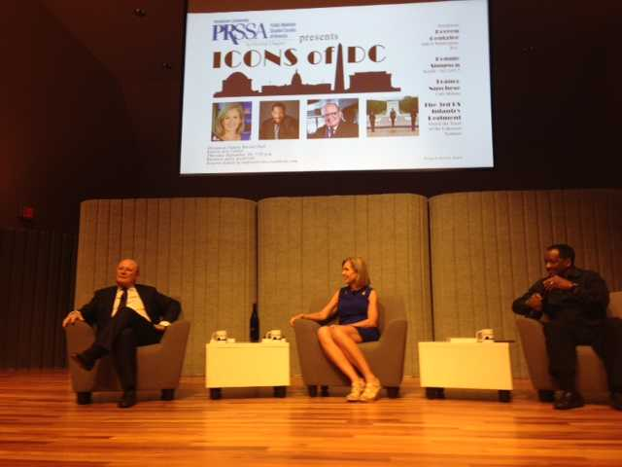
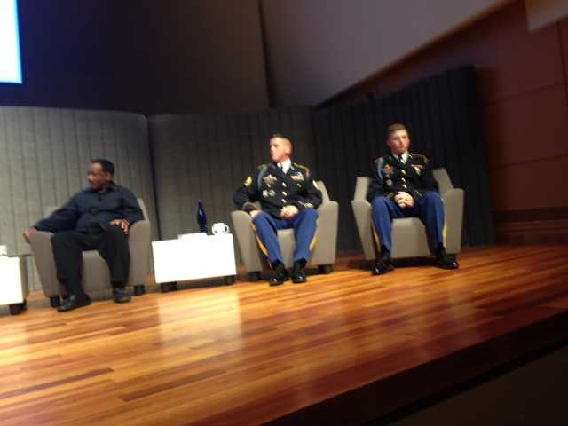
ICONS OF DC

Slide 11
Honored to have won best chapter
For Diversity from PRSSA in 2017.

Slide 12
Questions
QUESTIONS?

